Slide 1
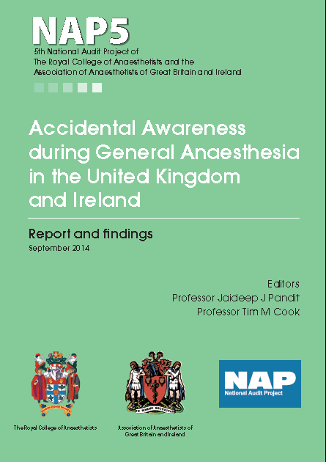

Slide 2
Introduction

Slide 3
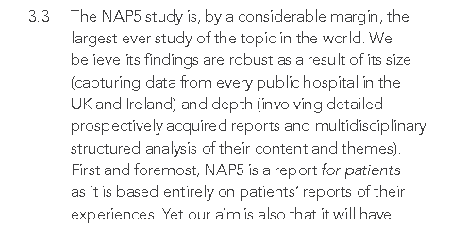
Introduction

Slide 4
Objectives

Slide 5
Objectives

Slide 6
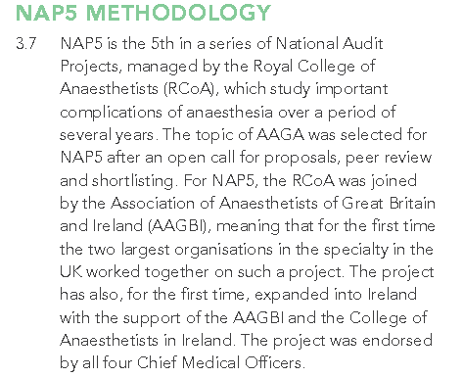
Methods

Slide 7
Methods

Slide 8
Findings

Slide 9
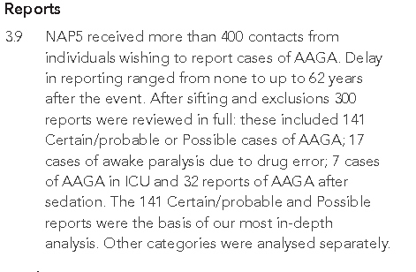
Findings

Slide 10
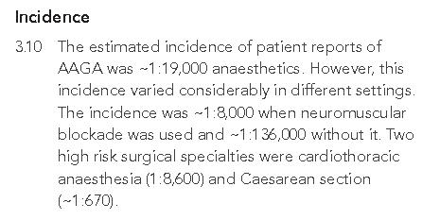
Findings

Slide 11
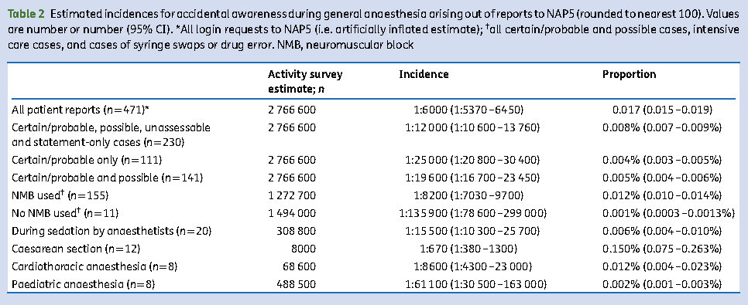
A range of incidences….

Slide 12
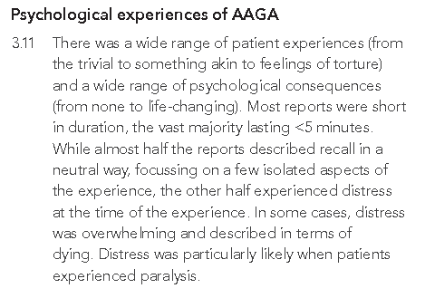
Findings

Slide 13
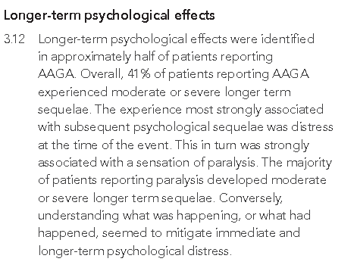
Findings

Slide 14
NAP5 pathway
See more at
http://www.nationalauditprojects.org.uk/NAP5-Anaesthetia-Awareness-Pathway

Slide 15
NAP5 pathway

Slide 16
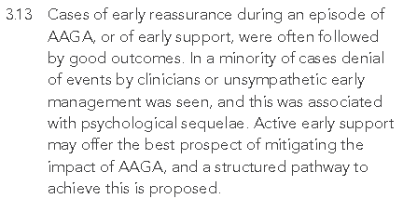
Findings

Slide 17
Findings

Slide 18
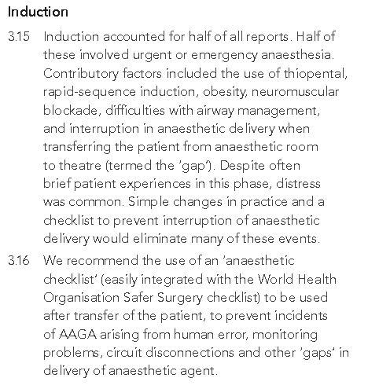
Findings

Slide 19
Induction - ‘Mind the gap’ checklist

Slide 20
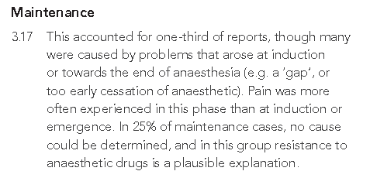
Findings

Slide 21
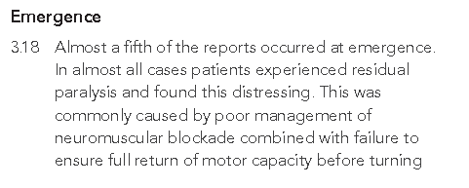
Findings

Slide 22
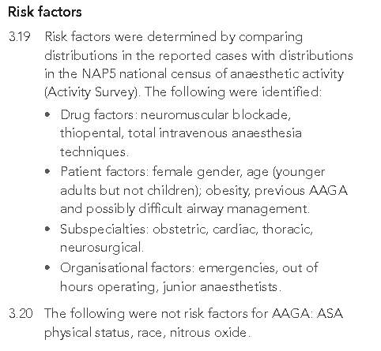
Findings

Slide 23
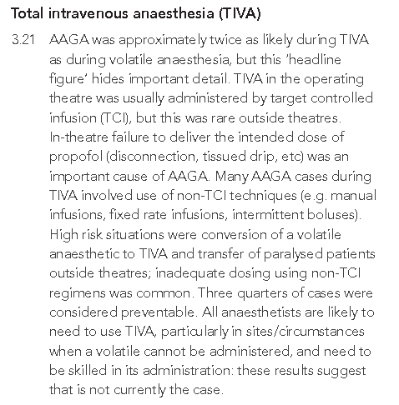
Findings

Slide 24
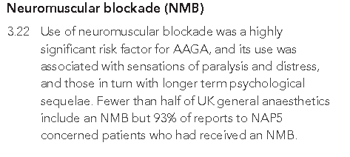
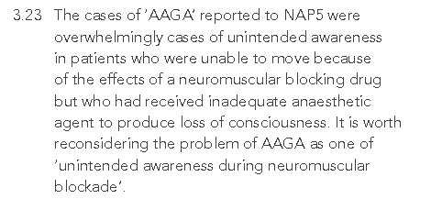
Findings

Slide 25
Notes:
Conceptually, unopposed global neuromuscular blockade is an intervention with capacity to cause great psychological harm, unless it is counteracted by general anaesthesia (as evident in syringe swap reports)
NAP5 contains reports of paralysis at induction, on transfer into theatre, during surgery, during transfer from theatre, and during recovery.
A disruption of the balance can occur at any time during anaesthesia.

Slide 26
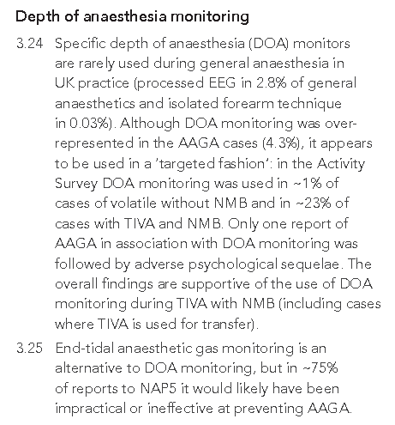
Findings

Slide 27
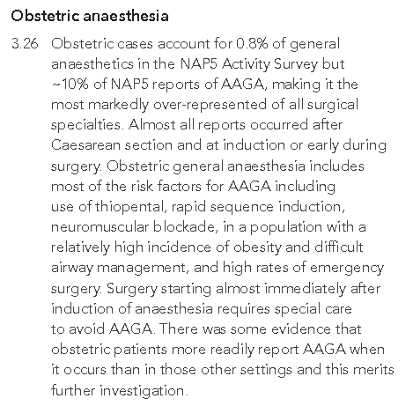
Findings

Slide 28
Findings

Slide 29
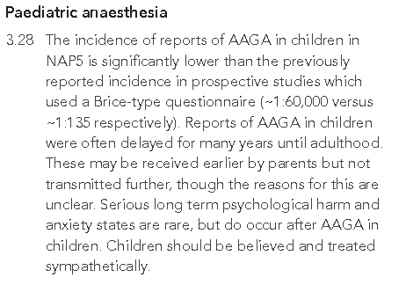
Findings

Slide 30
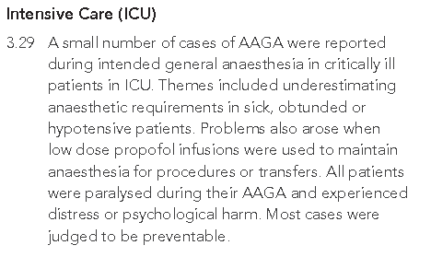
Findings

Slide 31
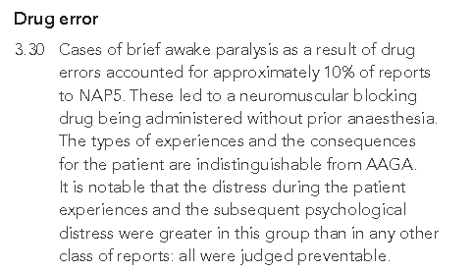
Findings

Slide 32
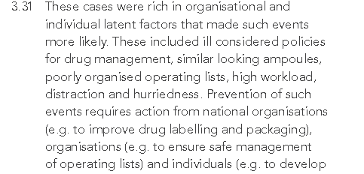
Findings

Slide 33
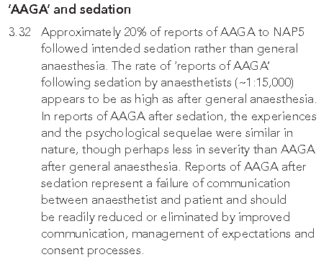
Findings

Slide 34
 | What will this feel like? | What will I remember? | What’s the risk related to the sedation drugs?
Not sedated: awake | I am awake, possibly anxious. There may be mild discomfort (depending on what I am having done) | Everything | Nearly zero
Minimal sedation | I am awake and calm. There may be mild or brief discomfort. | Probably everything | Very low
Moderate sedation | I am sleepy and calm but remain in control. I may feel mild discomfort. | I might remember some things | Low
Deep sedation | I am asleep, I will not be in control | Probably very little | Higher risk:My breathing may slow when I am asleep –and I may need help to breathe
Anaesthesia | I am deeply asleep and unable to respond. | Very unlikely to remember anything | Higher risk . My breathing may slow or stop and my BP and HR rate may fall. I will need a specialist doctor to look after me
Notes:
Here is a precis of a patient centred explanation. We have suggested a slightly more detailed version of this explanatory table for incorporation into patient literature. A copy is in NAP5 and in your handout.

Slide 35
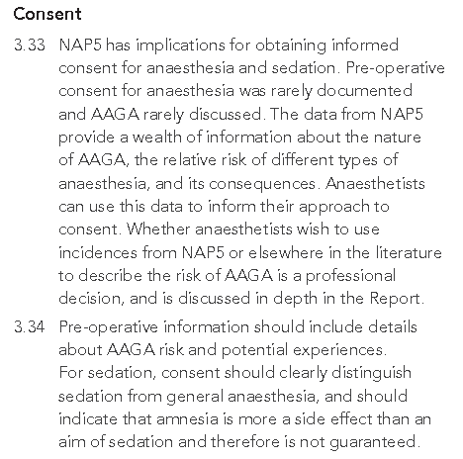
Findings

Slide 36
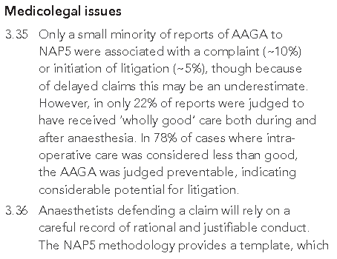
Findings

Slide 37
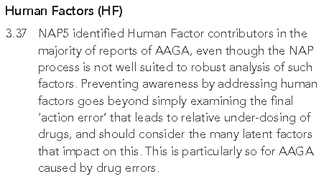
Findings

Slide 38
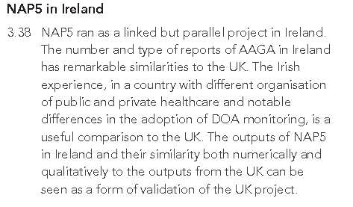
Findings

Slide 39
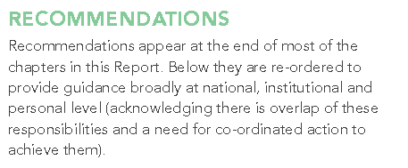
Recommendations

Slide 40
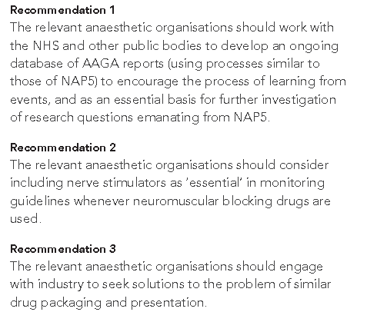
National recommendations

Slide 41
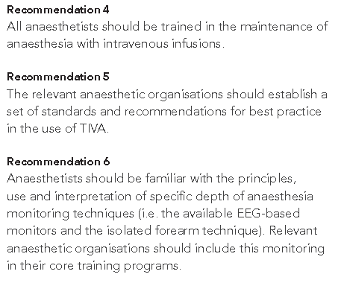
National recommendations

Slide 42
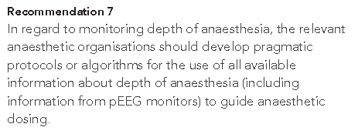
National recommendations

Slide 43
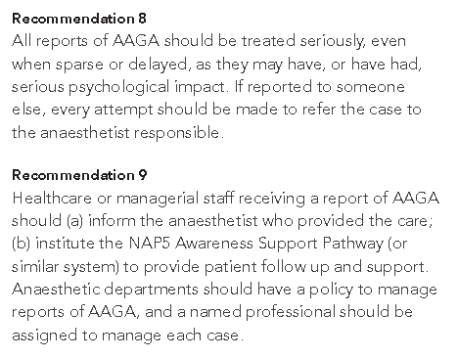
Institutional recommendations

Slide 44
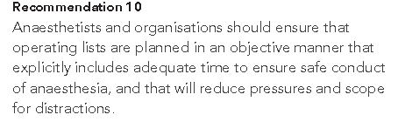
Institutional recommendations

Slide 45
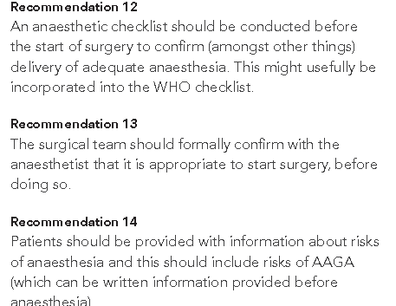
Institutional recommendations

Slide 46
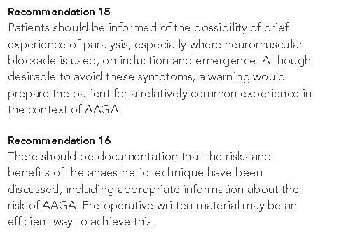
Institutional recommendations

Slide 47
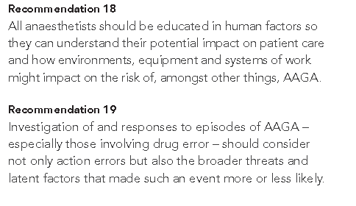
Institutional recommendations

Slide 48
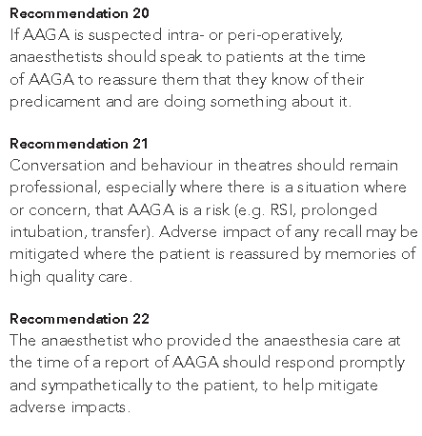
Individual practitioner recommendations

Slide 49
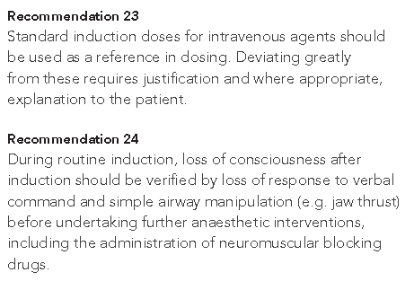
Individual practitioner recommendations

Slide 50
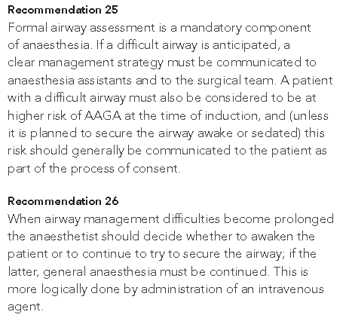
Individual practitioner recommendations

Slide 51
Individual practitioner recommendations

Slide 52
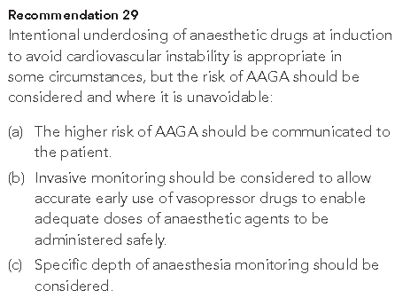
Individual practitioner recommendations

Slide 53
Individual practitioner recommendations

Slide 54
Individual practitioner recommendations

Slide 55
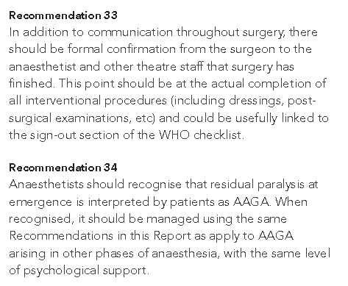
Individual practitioner recommendations

Slide 56
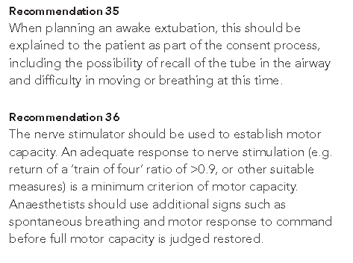
Individual practitioner recommendations

Slide 57
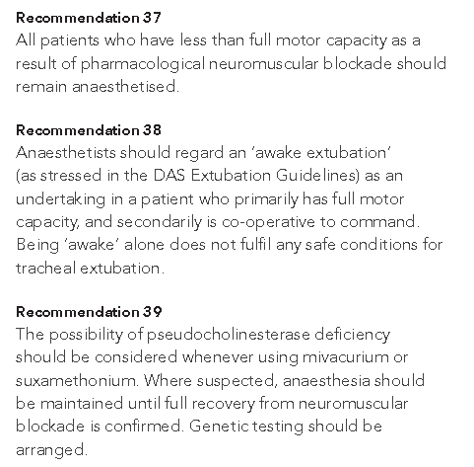
Individual practitioner recommendations

Slide 58
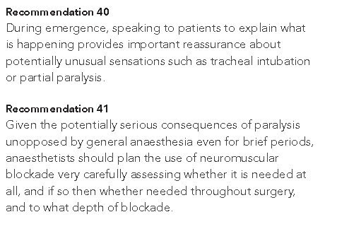
Individual practitioner recommendations

Slide 59
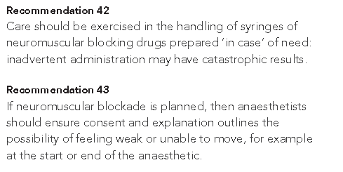
Individual practitioner recommendations

Slide 60
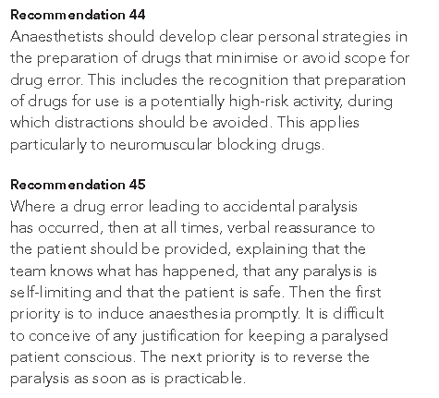
Individual practitioner recommendations

Slide 61
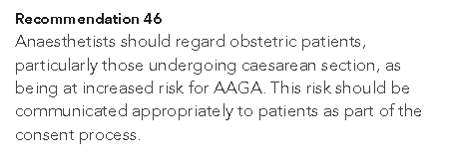
Individual practitioner recommendations

Slide 62
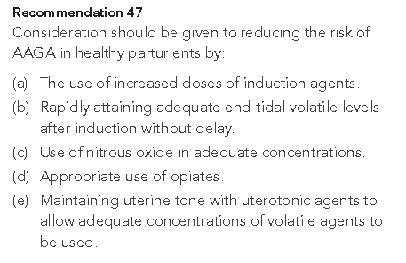
Individual practitioner recommendations

Slide 63
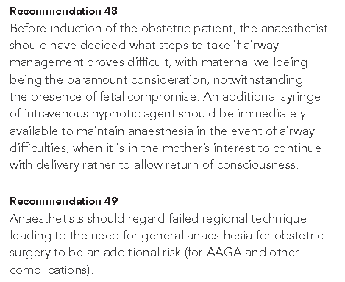
Individual practitioner recommendations

Slide 64
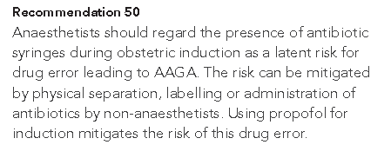
Individual practitioner recommendations

Slide 65
Individual practitioner recommendations

Slide 66
Individual practitioner recommendations

Slide 67
Individual practitioner recommendations

Slide 68
Individual practitioner recommendations

Slide 69
Individual practitioner recommendations

Slide 70
Individual practitioner recommendations

Slide 71
Individual practitioner recommendations

Slide 72
Individual practitioner recommendations

Slide 73
The END

